Slide 1

Optimizing Nested Queries with Parameter Sort Orders
Ravindra N. Guravannavar
Ramanujam H.S.
S. Sudarshan
Indian Institute of Technology Bombay

Slide 2
Nested Queries
Commonly encountered in practice
Queries having performance issues are often complex nested queries
In WHERE clause, and in SELECT clause (e.g. SQL/XML)
Queries invoking User-Defined Functions (UDFs)

Slide 3
An Example: Query Invoking a UDF
Find the turn-around time for high priority orders
SELECT orderid, TurnaroundTime(orderid, totalprice, orderdate)
FROM ORDERS WHERE order_priority=’HIGH’;
DEFINE TurnaroundTime(@orderid, @totalprice, @orderdate)
// Compute the order category with some procedural logic.
IF (@category = ‘A’)
SELECT max(L.shipdate – @orderdate) FROM LINEITEM L
WHERE L.orderid=@orderid;
ELSE
SELECT MAX(L.commitdate – @orderdate)
FROM LINEITEM L WHERE L.orderid=@orderid;
END;

Slide 4
Nested Iteration is Important
Most direct (and default) way of evaluating nested queries
Decorrelation is hard for certain classes of queries
  Requires new operators
  Overhead: create filter, join with inner, join result with outer
Queries invoking UDFs
  Decorrelation possible only in very limited cases
Nested iteration can be cheapest option
  E.g. indexed NL join with small outer relation

Slide 5
Representing Nested Queries and Queries with UDFs
SELECT PO.order_id
FROM PURCHASEORDER PO
WHERE default_ship_to
NOT IN ( SELECT ship_to
FROM ORDERITEM OI WHERE OI.order_id =
PO.order_id );
A *
Bind Expression
Use Expression
B:$a, $b
U:$a, $b
A – The Apply Operator [Galindo-Legaria et.al. SIGMOD 2001]
* – Operation between the outer tuple and result of the inner block

Slide 6
UDFs Represented with Apply
DEFINE fn(p1, p2, … pn) AS
BEGIN
fnQ1 <p1, p2>;
fnQ2 <p1, p2, p3>;
IF (condition)
fnQ3<p2>;
ELSE
fnQ4<p3>;
// Cursor loop binding v1, v2
OPEN CURSOR ON fnQ5<p2, p3>;
LOOP
fnQ6<p1, p2, v1, v2>;
END LOOP
END
A
Q_{i}
fnQ₁
fnQ₂
fnQ₃
fnQ₄
A
fnQ₅
fnQ₆

Slide 7
Making Nested Iteration Better
Reuse invariants (System R, Rao & Ross [SIGMOD 98])
Caching inner query results (System R, Graefe [BTW 03]
Ordering the correlation bindings/parameters
  Allows us to cache a single inner result (System R)
  Advantageous buffer effects (Graefe [BTW 2003])
Evaluation optimizations (Graefe [BTW 2003])
  E.g. prefetching/asynchronous I/O, batched bindings
  Does not consider query optimization
New Physical Operators
  Restartable table scan
  Incremental aggregate

Slide 8
Restartable Table Scan
Parameters produced to match the sort order of the inner relation
Retain the scan state across function calls
Example: Query with UDF
Parameter Bindings
Table LINEITEM
orderid, totalprice, orderdate
orderid
lineitemid
shipdate
{100, 20.5, 2005-01-02}
100
1
2005-01-10
{140, 10.2, 2005-01-04}
100
2
2005-01-12
140
1
2005-01-04
{200, 30.8, 2005-02-01}
200
1
2005-02-02
200
2
2005-02-01

Slide 9
Incremental Computation of Aggregates
SELECT day, sales
FROM DAILYSALES DS1
WHERE sales > (SELECT MAX(sales)
FROM DAILYSALES DS2
WHERE DS2.day < DS1.day);
Applicable to:
Aggregates SUM, COUNT, MAX, MIN, AVG and
Predicates <, ≤,>, ≥

Slide 10
Query Optimization with Nested Iteration
A multi-level, multi-branch query
Plan cost for a block: A function of the order guaranteed on the IN variables and order required on the OUT variables
Not every possible sort order may be useful (only interesting orders)
Not every interesting order may be feasible/valid
B1
B2
B4
B3
B5
B6
B7
BIND variable set
USE variables set
B8
B9

Slide 11
Optimizing with Parameter Sort Orders
Top-Down Exhaustive Approach
For each possible sort order of the parameters, optimize the outer block and then the inner block.
A query block b at level l using n parameters will get optimized d(k)^{l} times where,
d(k)=^{k}p₀ +^{k}p₁ + … ^{k}p_{k}
Assuming an average of k=n/l parameters are bound at each block above b.
And ^{k}p_{i} = k!/(k-i)!

Slide 12
Optimizing with Parameter Sort Orders
Our proposal: Top-Down Multi-Pass Approach
  Traverse the inner block(s) to find all valid, interesting orders.
  For each valid, interesting order ord
    Optimize the (outer) block with ord as the required output sort order (physical property).
    Then optimize the inner block(s) with ord as the guaranteed parameter sort order.
    Keep the combination, if it is cheaper than the cheapest plan found so far.

Slide 13
Feasible/Valid Parameter Sort Orders
Parameter sort order (a₁, a₂, … a_{n}) is valid iff
  level(a_{i}) <= level(a_{j}) for all i, j s.t. i < j
Weaker than regular notion of sort order
  Bindings for nested blocks can cycle for a given value of outer variables
B1
Binds p1 - sorted
B2
Binds p2 - sorted
B3
(p1,p2) not valid with the regular definition

Slide 14
Plan Generation
A
Required Output
Sort Order
Interesting Parameter
Sort Order
A
Query Block-1
Binds $a, $b
Query Block-2
Query Block-3
Binds $c
Uses $a,$b
Uses $a, $b, $c

Slide 15
Plan Generation (Contd.)
At the Apply node
  Traverse the use inputs and obtain valid interesting orders
  Extract orders relevant to the bind input
  Optimize the bind input making the order as a required output physical property
  Optimize the use input making the order as a guaranteed parameter sort order
At a non-Apply node
  Consider only those algorithms that require parameter sort order weaker than or equal to the guaranteed sort order

Slide 16
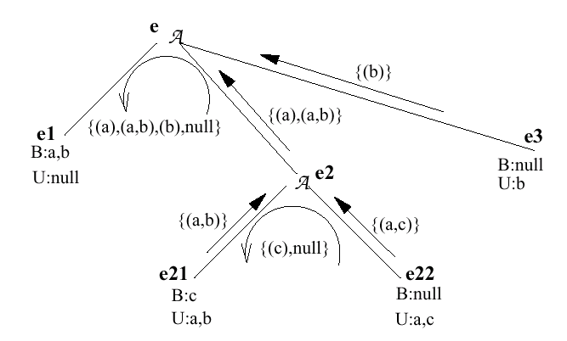
Sort Order Propagation for a Multi-Level Multi-Branch Expression
sc1=a ^ c2=b (R2)
R2 sorted on (c1,c2)

Slide 17
Experiments
Evaluated the benefits of state retention plans with PostgreSQL
Scan and Aggregate operators were modified for state retention
Plans were hard coded as the Optimizer extensions are not yet ready
The decorrelation plans were hand coded as PostgreSQL (7.3.4) does not decorrelate nested queries.

Slide 18
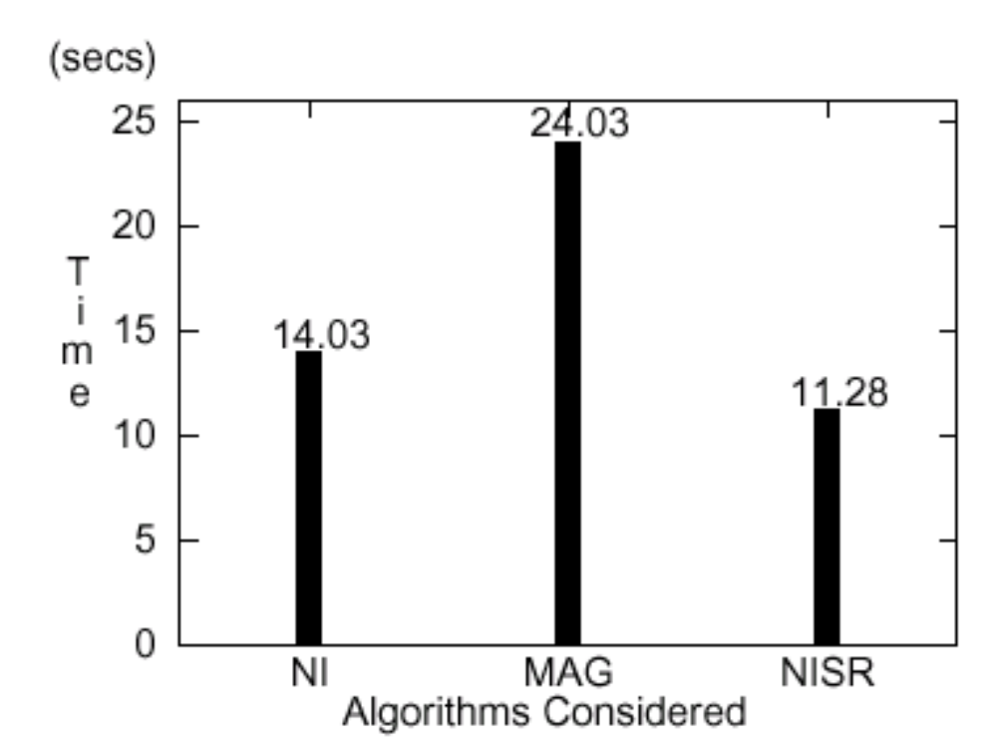
Experiments (Contd.)
A simple IN query with no outer predicates
SELECT o_orderkey FROM ORDERS WHERE o_orderdate IN (SELECT l_shipdate FROM LINEITEM WHERE l_orderkey = o_orderkey);
NI – Nested Iteration
MAG – Magic Decorrelation [SPL96]
NISR – NI with State Retention
Note: MAG is just one form of decorrelation, and the comparison here is NOT
with decorrelation techniques in general

Slide 19
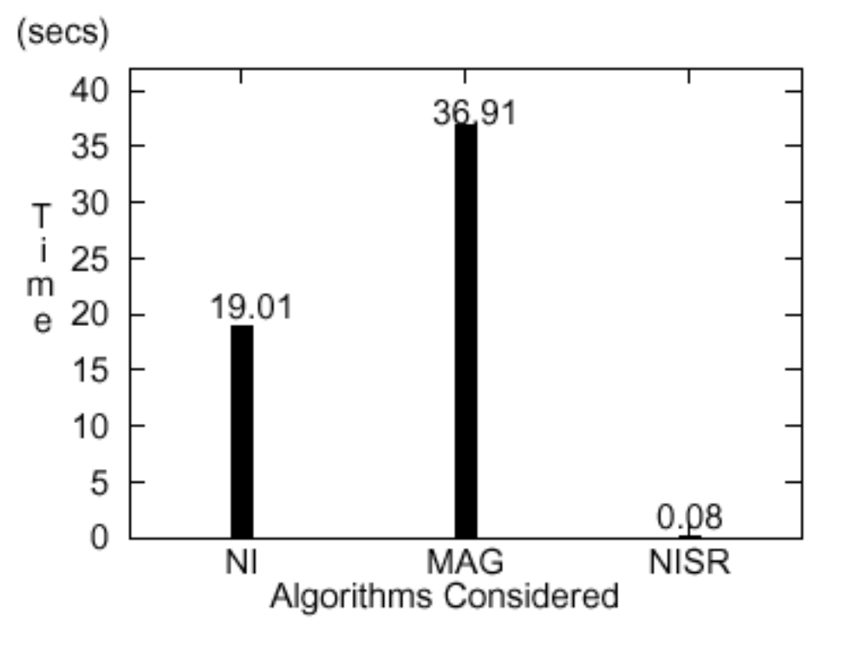
Experiments (Contd.)
A Nested Aggregate Query with Non-Equality Corrl. Predicate
SELECT day, sales FROM DAILYSALES DS1 WHERE sales > (SELECT MAX(sales) FROM DAILYSALES DS2 WHERE DS2.day < DS1.day);

Slide 20
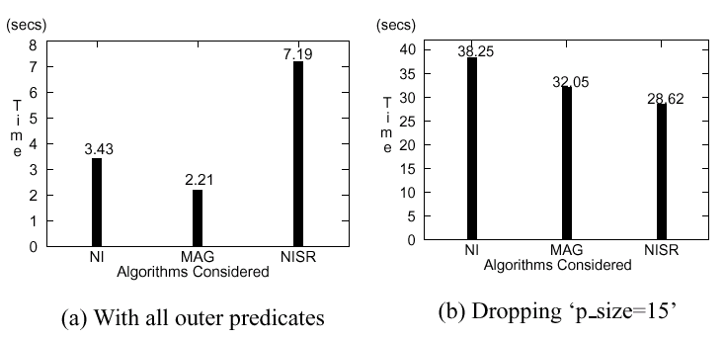
Experiments (Contd.)
TPC-H MIN COST Supplier Query
SELECT name, address … FROM PARTS, SUPPLIER, PARTSUPP
WHERE nation=’FRANCE’ AND p_size=15 AND p_type=’BRASS’ AND <join_preds>
AND ps_supplycost = ( SELECT min(PS1.supplycost) FROM …);

Slide 21
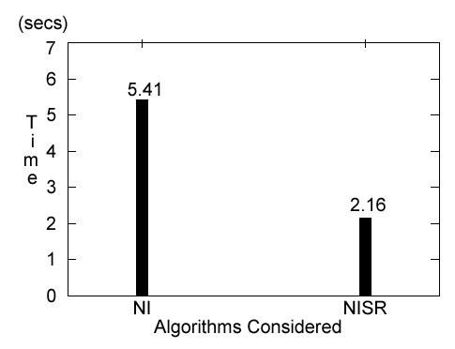
Experiments (Contd.)
A query with UDF
SELECT orderid, TurnaroundTime(orderid,
totalprice, orderdate)
FROM ORDERS WHERE order_priority=’H’;
DEFINE TurnaroundTime(@orderid, @totalprice,
@orderdate)
// Compute the order category with some procedural logic.
IF (@category = ‘A’)
SELECT max(L.shipdate – @orderdate)
FROM LINEITEM L
WHERE L.orderid=@orderid;
ELSE
SELECT MAX(L.commitdate – @orderdate)
FROM LINEITEM L
WHERE L.orderid =@orderid;
END;

Slide 22
Future Work
Factoring execution probabilities of queries inside function body for appropriate costing
  Analyze function body
  Exploit history of execution (when available)
Parameter properties other than sort orders that would be interesting to nested queries and functions

Slide 23
Questions?

Slide 24
Extra Slides

Slide 25
Physical Plan Space Generation
PhysEqNode PhysDAGGen(LogEQNode e, PhyProp p, ParamSortOrder s)
If a physical equivalence node n_{p} exists for e, p, s
return n_{p}
Create an equivalence node n_{p} for e, p, s
For each logical operation node o below e
If(o is an instance of ApplyOp)
ProcApplyNode(o, s, n_{p})
else
ProcLogOpNode(o, p, s, n_{p})
For each enforcer f that generates property p
Create an enforcer node o_{f} under n_{p}
Set the input of o_{f} = PhysDAGGen(e, null, s)
return n_{p}
End

Slide 26
Processing a Non-Apply Node
void ProcLogOpNode(LogOpNode o, PhysProp p,ParamSortOrder s,
PhysEqNode n_{p})
For each algorithm a for o that guarantees p and
requires no stronger sort order than s
Create an algorithm node o_{a} under n_{p}
For each input i of o_{a}
Let o_{i} be the i ^{th} input of o_{a}
Let p_{i} be the physical property required
from input i by algorithm a
Set input i of o_{a} = PhysDAGGen(o_{i}, p_{i}, s)
End

Slide 27
Processing the Apply Node
void ProcApplyNode(LogOpNode o, ParamSortOrder s, PhysEqNode np)
Initialize i_ords to be an empty set or sort orders
For each use expression u under o
uOrds = GetInterestingOrders(u)
i_ords = i_ords Union uOrds
l_ords = GetLocalOrders(i ords, o.bindInput)
For each order ord in l_ords and null
leq = PhysDAGGen(lop.bindInput, ord, s)
Let newOrd = concat(s, ord)
applyOp = create new applyPhysOp(o.TYPE)
applyOp.lchild = leq
For each use expression u of o
ueq = PhysDAGGen(u, null, newOrd)
Add ueq as a child node of applyOp
np.addChild(applyOp)
End

Slide 28
Generating Interesting Parameter Orders
Set<Order> GetInterestingOrders(LogEqNode e)
if the set of interesting orders i_ords for e is already found
return i_ords
Create an empty set result of sort orders
for each logical operation node o under e
for each algorithm a for o
Let s_{a} be the sort order of interest
to a on the unbound parameters in e
if s_{a} is a valid order and s_{a} is not in result
Add s_{a} to result
for each input logical equivalence node e_{i} of a
childOrd = GetInterestingOrders(e_{i})
if (o is an Apply operator AND e_{i} is a use input)
childOrd = GetAncestorOrders(childOrd, o.bindInput)
result = result Union childOrd
return result
End

Slide 29
Extracting Ancestor Orders
Set<Order> GetAncestorOrders(Set<Order> i_ords, LogEqNode e)
Initialize a_ords to be an empty set of sort orders
for each order ord in i_ords
newOrd = Empty vector;
for (i = 1; i <=length(ord); i = i + 1)
if ord[i] is NOT bound by e
append(ord[i], newOrd)
else
break;
add newOrd to a_ords
return a_ords
End

Slide 30
Extracting Local Orders
Set<Order> GetLocalOrders(Set<Order> i_ords, LogEqNode e)
Initialize l_ords to be an empty set or sort orders
For each ord in i_ords
newOrd = Empty vector;
For (i =length(ord); i > 0; i = i – 1 )
If ord[i] is bound by e
prepend(ord[i], newOrd)
Else
break;
add newOrd to l_ords
return l_ords
End

Slide 31
Extensions to the Volcano Optimizer
Contract of the original algorithm for optimization:
Plan FindBestPlan(Expr e, PhysProp rpp, Cost cl)
Contract of the modified algorithm for optimization:
Plan FindBestPlan(Expr e, PhysProp rpp, Cost cl,
Order pso, int callCount)
Plans generated and cached for <e, rpp, pso, callCount>
Not all possible orderings of the parameters are valid
  Parameter Sort Order (a₁, a₂, … a_{n}) is valid iff level(a_{i}) <= level(a_{j}) for all i, j s.t. i < j.
  Not all valid orders may be interesting (we consider only valid, interesting parameter sort orders)

Slide 32
A Typical Nested Iteration Plan
For t_{i} ← {t₁, t₂, t₃, … t_{n}} do
innerResult = {Ø}
For u_{i} ← {u₁, u₂, u₃, … u_{m}} do
    if (pred(t_{i} ,u_{i}))
    Add u_{i} to innerResult;
  done;
  process(t_{i} ,innerResult);
done;

Slide 33
Benefits of Sorting for a Clustered Index
400
Case-1
Keys: 50, 500,400,80,600,200
Potential data block fetches=6
* Assume a single data block
can be held in memory
Random I/O
Case-2
Keys: 50,80,200,400,500,600
Data block fetches=3
Sequential I/O
50
80
200
400
500
600
Data Block-1
Data Block-2
Data Block-3
* We provide cost estimation for clustered index scan taking the buffer effects into account (full length paper)

Slide 34
Difference from Join Optimization
Block-1
B:{R1.a, R1.b}
Sort on R1.a
R2
Block-2
B:{R2.c}
U:{R1.a}
Sort on R3.b
R1
R3
Not an option for Nested Iteration
Block-3
U:{R1.b, R2.c}

Slide 35
A Stricter Notion of Validity
  Parameter sort order (a₁, a₂, … a_{n}) is valid iff
    level(a_{i}) <= level(a_{j}) for all i, j s.t. i < j
    AND
  For each block b_{k} s.t. level(b_{i}) - level(b_{k}) > 1,
  linkattrs(b_{k}, s) U bindattrs(b_{k}, s) is a candidate key of the schema of the expression in the FROM clause of b_{k}.
Notation:
level(b_{i}): Level of the block b_{i}
level(a_{i}): Level of the block in which a_{i} is bound
bindattrs(b_{k}, s): Attributes in s that are bound at block b_{k}
linkattrs(b_{k}, s): Atttributes in b_{k} that are linked with attributes in s
with an equality predicate.

